Slide 1
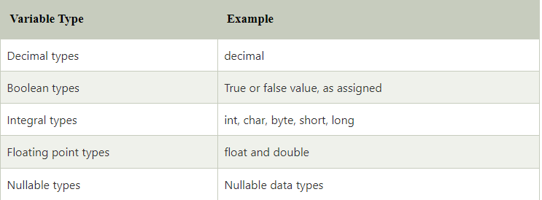
C# Variables
A variable is a name of memory location. It is used to store data. Its value can be changed and it can be reused many times.
It is a way to represent memory location through symbol so that it can be easily identified.

Slide 2
C# Variables
Syntax of variable declaration
type variable_list;
Example:
int i, j;
double d;
float f;
char ch;

Slide 3
C# Variables
We can also provide values while declaring the variables as given below:
Example:
int i=2,j=4; //declaring 2 variable of integer type
float f=40.2;
char ch='B';

Slide 4
C# Variables
Rules for defining variables
A variable can have alphabets, digits and underscore.
A variable name can start with alphabet and underscore only. It can't start with digit.
No white space is allowed within variable name.
A variable name must not be any reserved word or keyword e.g. char, float etc.

Slide 5
C# Variables
Valid variables
int x;
int _x;
int k20;
Invalid variables
int 4;
int x y;
int double;

Slide 6
Next…
Data types

